Slide 1
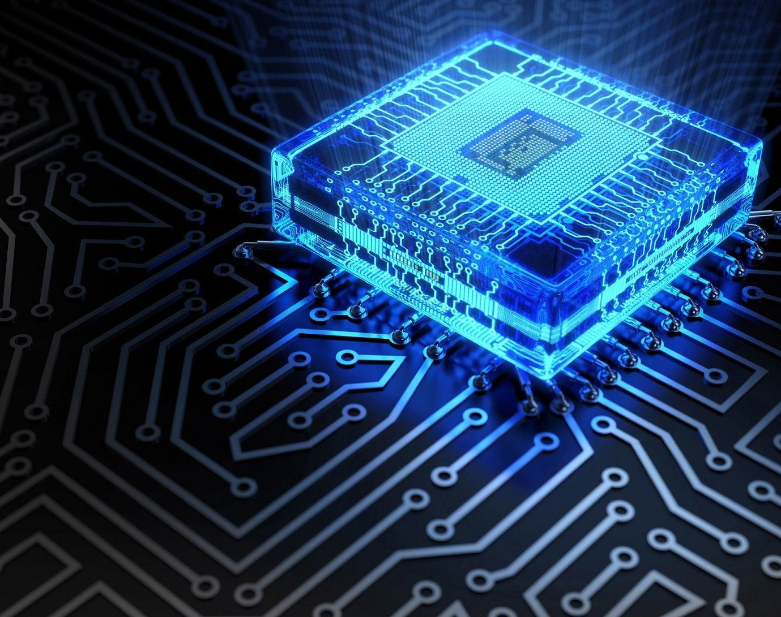
Simulate Real-time Clock in 8085 Microprocessor
Nitin Sharma
Enrollment No.: 18111020
3rd-year Engineering Physics, IIT Roorkee

Slide 2
Contents:
Logic behind a Real-time Clock
Code for each part in flow chart
Complete code for 24 Hour clock
12 hour clock logic
Complete Code for 12 hour clock

Slide 3
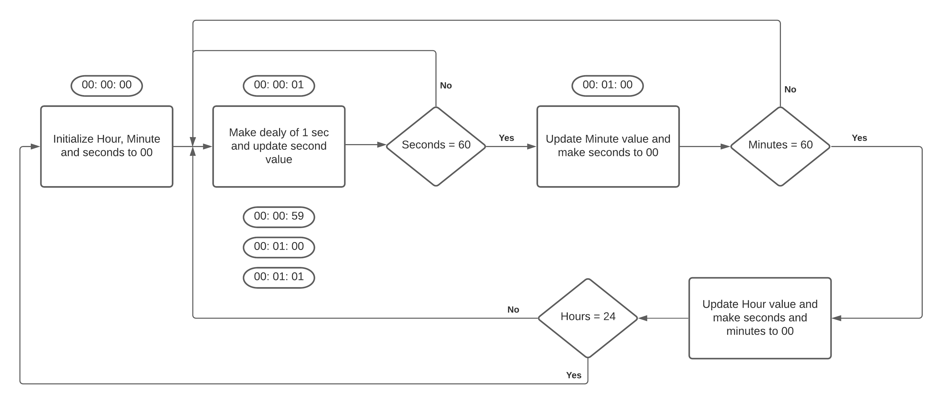
Flow chart for simulating Real-time Clock
in 8085 Microprocessor

Slide 4
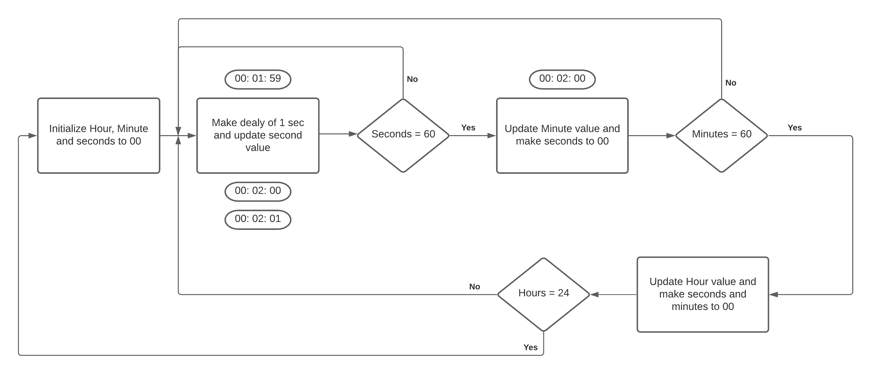

Slide 5
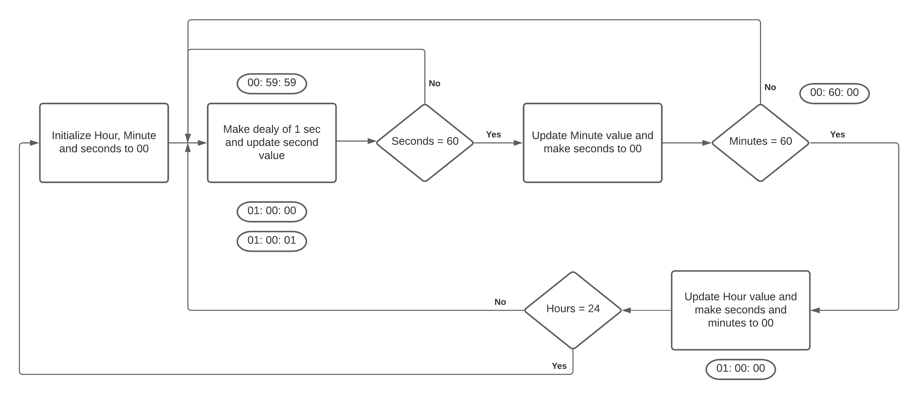

Slide 6
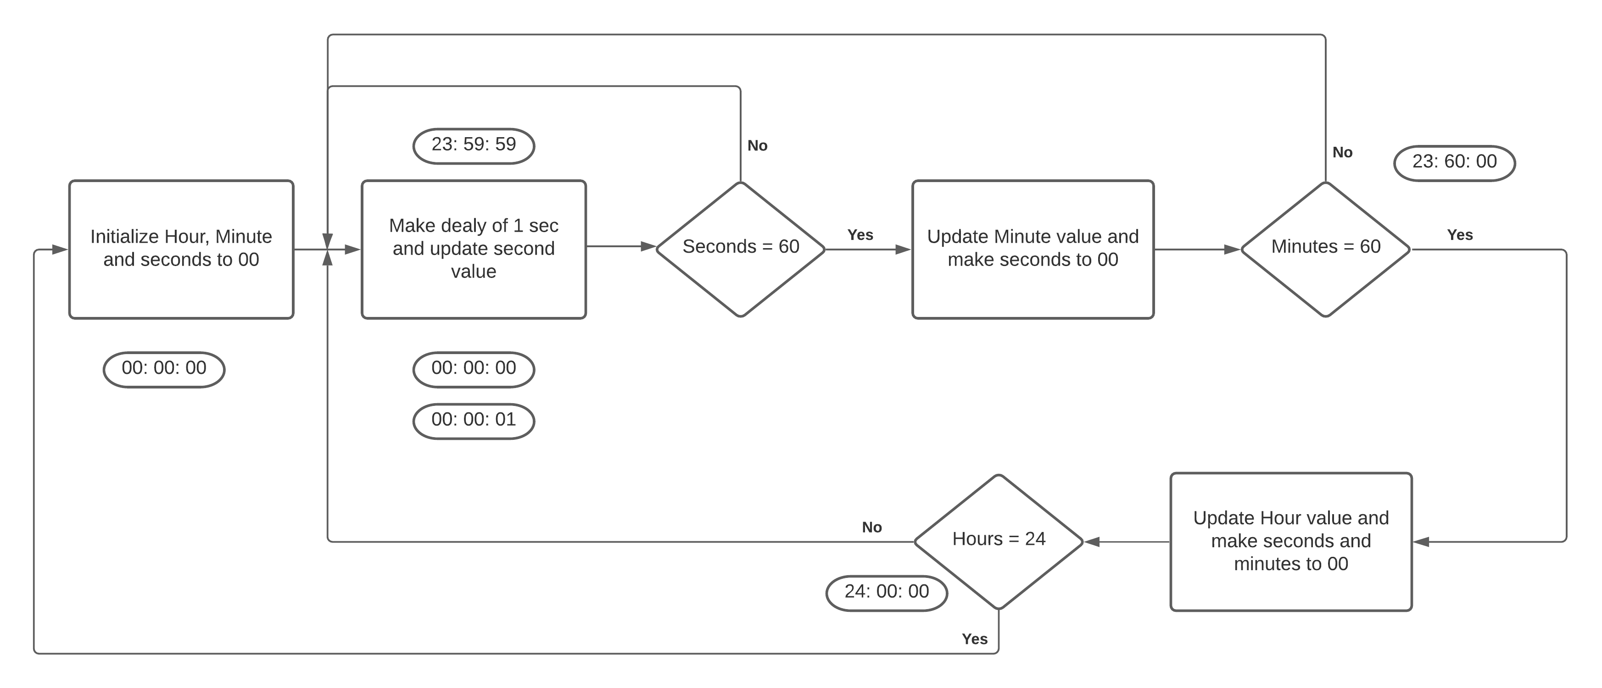

Slide 7
Coding Part

Slide 8
24 Hour Clock

Slide 9
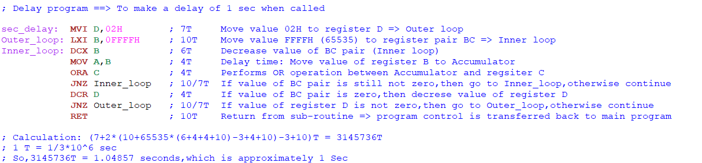
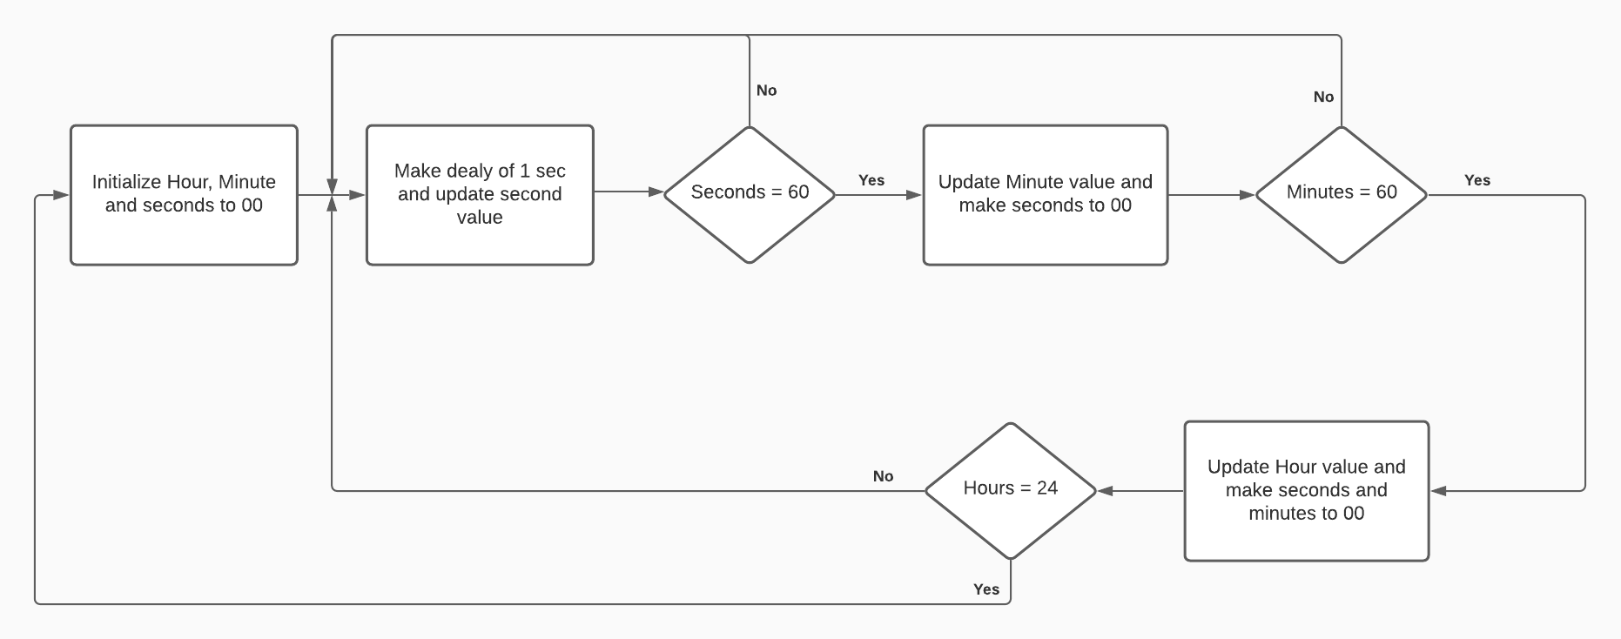
Delay for 1 Sec

Slide 10
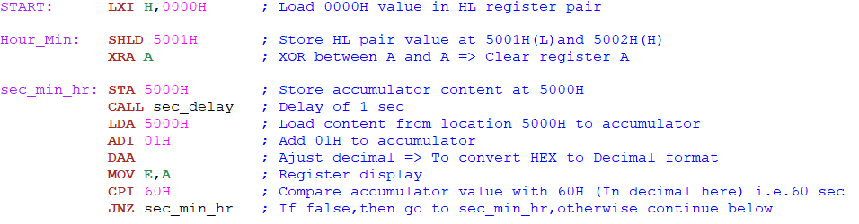
Initialize Sec, Min, Hour and 1 sec delay
H=> Hour (5002H) L=> Minute (5001H) E=> Seconds (5000H)

Slide 11
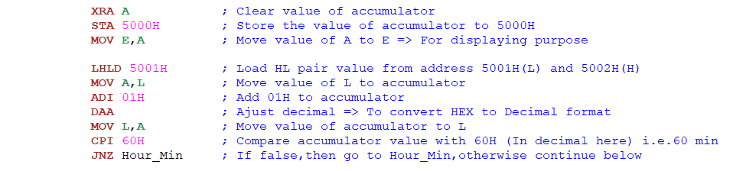
Update Minute and set Sec to zero
H=> Hour (5002H) L=> Minute (5001H) E=> Seconds (5000H)

Slide 12
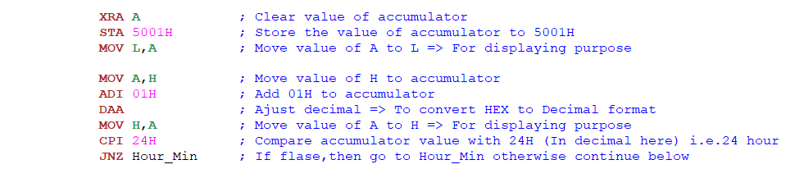
Update Hour and set Sec and Min to zero
H=> Hour (5002H) L=> Minute (5001H) E=> Seconds (5000H)

Slide 13
Update Hour and set Sec and Min to zero
H=> Hour (5002H) L=> Minute (5001H) E=> Seconds (5000H)

Slide 14
Initialize Sec, Min, Hour and 1 sec delay
H=> Hour (5002H) L=> Minute (5001H) E=> Seconds (5000H)

Slide 15
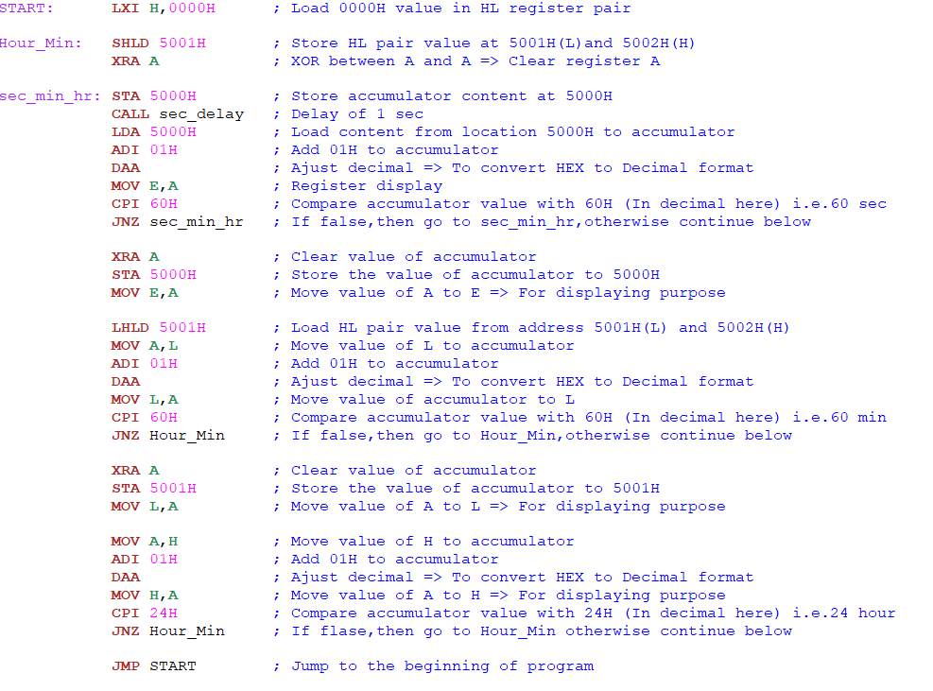
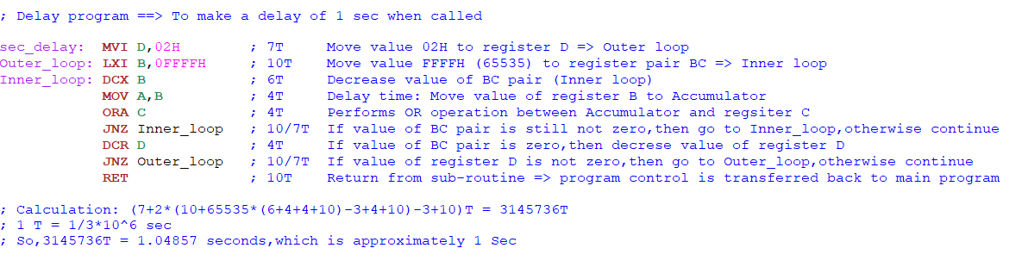
Complete Code for 24 Hour Clock
Initialize Hour, Minute and Seconds as zero
Update second after 1 second delay
Update Minute after 60 seconds
Update Hour after 60 minute
Restart the code after 24 Hours
Delay program for 1 second

Slide 16
12 Hour Clock

Slide 17
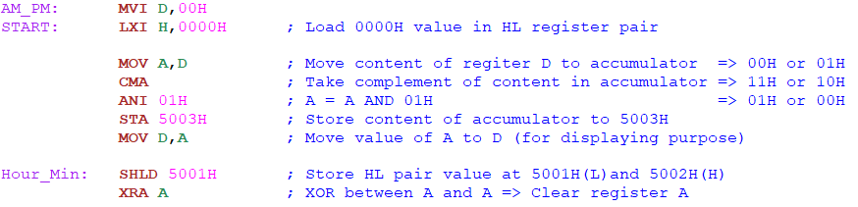
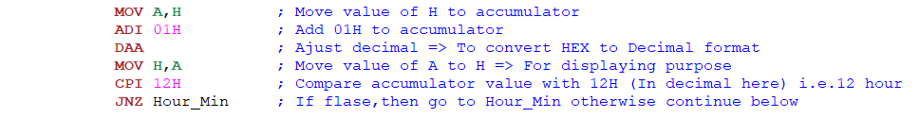
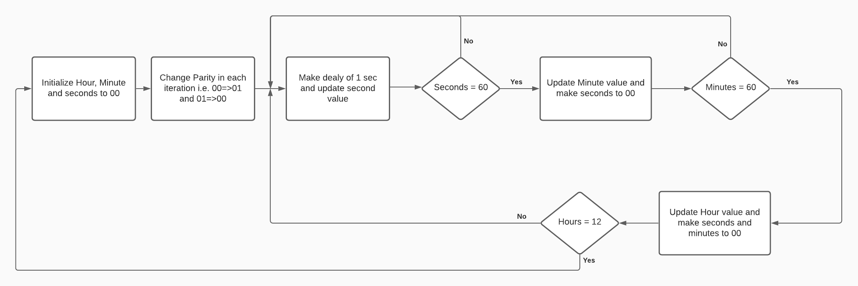
Changes required for 12 Hour Clock
H=> Hour (5002H)
L=> Minute (5001H)
E=> Seconds (5000H)
D=> AM(01H)/PM(00H) (5003H)
And Change 00 => 01 and 01 => 00

Slide 18
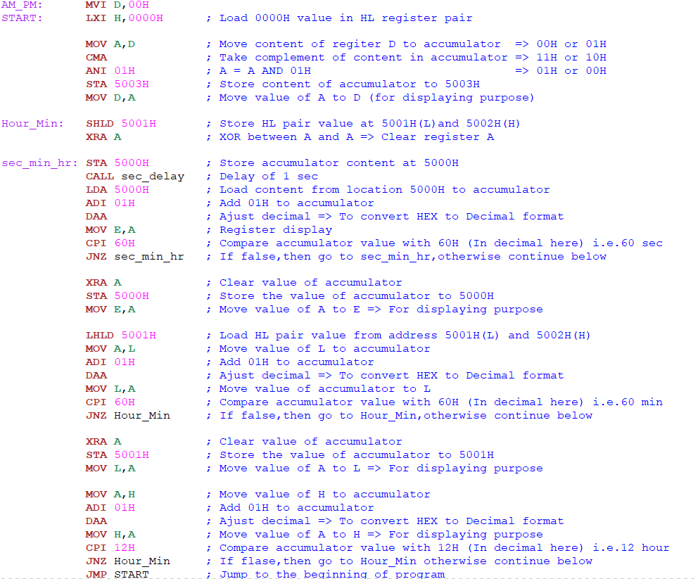
Complete Code for 12 hour Clock
Initialize Hour, Minute and Seconds and Parity as zero
Change Parity from 00 to 01 and from 01 to 00 in each iteration
Update second after 1 second delay
Update Minute after 60 seconds
Update Hour after 60 minute
Restart the code after 12 Hours
Delay program for 1 second

Slide 19
Thank You

